Slide 1
Presentation brief for MCT’s
Title of presentation | Explore, transform, and load data into the Data Warehouse using Apache Spark
Presentation\Lab length | Presentation: 50 - 60 minutes Lab: 50 – 60 minutes
Audience | Data Engineers, Data Scientists, Data Professionals, Data Architects, BI Professionals, Developers.
Purpose | Understand big data engineering with Apache Spark in Azure Synapse Analytics Perform data ingestion using Apache Spark notebooks in Azure Synapse Analytics How to transform data with DataFrames in Apache Spark Pools in Azure Synapse Analytics Integrating SQL and Apache Spark pools in Azure Synapse Analytics
(think) Student key takeaways | The student should understand data engineering concepts using Apache Spark in Azure Synapse Analytics The student should understand the role of a Apache Spark notebooks to ingest data The student should be able to transform data with DataFrames in Apache Spark Pools The student should comprehend the integration with SQL and Apache Spark Pools
(feel) Student desired mindset | The student may feel confusion about the different Spark options that are available and which one to use The student may feel more confident in using SQL syntax in Apache Spark notebooks The student may feel they are not familiar with DataFrames, PySpark or SparkSQL and may need help understanding the code in the lab
(do) Student outcomes | The student should be able to articulate a one sentence description of the Apache Spark technology used in Azure Synapse Analytics The student should be able to understand use cases for Apache Spark Pools in Azure Synapse Analytics The students should be able to understand the spark code in the lab and what it is doing
More information | For MCT course feedback, visit the Microsoft Official Courseware forum
Notes:
Instructor notes and guidance.
This slide is for MCT use only, outlining the aims and objectives of this module.

Slide 2
DP-203T00: Explore, transform, and load data into the Data Warehouse using Apache Spark
Notes:
Instructor notes and guidance.
Introduce to the students that in this module they will explore, transform, and load data into the Data Warehouse using Apache Spark
You will start out by talking about Spark at a technology agnostic level first, and then comment on how this is a specific component of Azure Synapse Analytics that can help you work with big data engineering workloads as Apache Spark intended. In the second slide we will focus on working with an Apache Spark cluster in Azure Synapse Analytics and how we can interact with this using notebooks. This use case will explore transforming data with DataFrames in Apache Spark pools in Azure Synapse Analytics. You will then explore how to integrate data from a Spark pool into a dedication SQL pool.
In this lab, we take to opportunity to explore data stored in a data lake, transform the data, and load data into a relational data store. The student will explore Parquet and JSON files and use techniques to query and transform JSON files with hierarchical structures. Then the student will use Apache Spark to load data into the data warehouse and join Parquet data in the data lake with data in the dedicated SQL pool.

Slide 3

Agenda
Lesson 01 – Understand big data engineering with Apache Spark in Azure Synapse Analytics
Lesson 02 – Ingest data with Apache Spark notebooks in Azure Synapse Analytics
Lesson 03 – Transform data with DataFrames in Apache Spark Pools in Azure Synapse Analytics
Lesson 04 – Integrate SQL and Apache Spark pools in Azure Synapse Analytics
Notes:
Instructor notes and guidance.
This space has been left deliberately blank.

Slide 4
Lesson 01: Understand big data engineering with Apache Spark in Azure Synapse Analytics
Notes:
Instructor notes
This space has been left deliberately blank

Slide 5
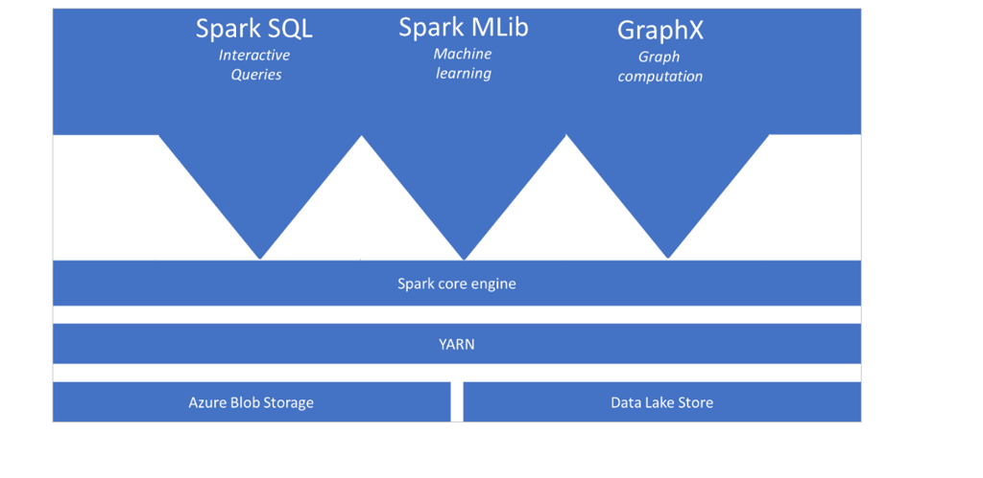
Introduction to big data engineering with Apache Spark in Azure Synapse Analytics
Notes:
Talking Points:
​
Apache Spark:
Apache Spark is a parallel processing framework that supports in-memory processing to boost the performance of big-data analytic applications. ​Apache Spark in Azure Synapse Analytics is one of Microsoft's implementations of Apache Spark in the cloud. Azure Synapse makes it easy to create and configure a Spark pool in Azure Synapse Analytics. Spark pools in Azure Synapse are compatible with Azure Storage and Azure Data Lake Generation 2 Storage, so you can use Azure Spark pools to process your data stored in Azure.​
Spark architecture
The architecture depicted in this slide shows the components of Spark. Spark is compatible with Azure Storage and Azure Data Lake Storage. Apache Spark in Azure Synapse uses YARN Apache Hadoop YARN. Yarn controls the maximum sum of memory used by all containers on each of the Spark nodes.
The spark core engine is a distributed execution engine. On top is the distributed execution engine, you can have different functionalities that can interact with the Spark core engine that you will add as required. Examples include Spark SQL for interactive queries, Spark Mlib for machine learning and GraphX for graph computations. This enables you to set up diverse workloads on a single platform.
​
Instructor notes and guidance.
Note that this architecture is both valid for Apache Spark pools in Azure Synapse Analytics as well as for Azure Databricks. It outlines the general understanding of what Apache Spark is and how it interacts with different services. ​
​
Recommended reading for this slide
https://docs.microsoft.com/en-us/learn/modules/understand-big-data-engineering-with-apache-spark-azure-synapse-analytics/2-what-is-apache-spark-pool

Slide 6
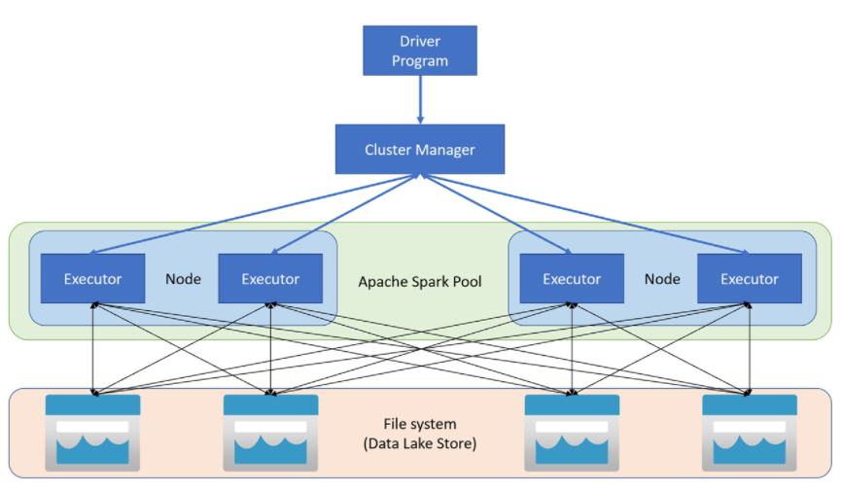
How do Apache Spark pools work in Azure Synapse Analytics
Notes:
Talking Points:
Within Azure Synapse Analytics, Apache Spark applications run as independent sets of processes on a pool, coordinated by the SparkContext object in your main program (called the driver program). The SparkContext can connect to the cluster manager, which allocates resources across applications. The cluster manager is Apache Hadoop YARN. Once connected, Spark acquires executors on nodes in the pool, which are processes that run computations and store data for your application. Next, it sends your application code (defined by JAR or Python files passed to SparkContext) to the executors. Finally, SparkContext sends tasks to the executors to run.
The SparkContext runs the user's main function and executes the various parallel operations on the nodes. Then, the SparkContext collects the results of the operations. The nodes read and write data from and to the file system. The nodes also cache transformed data in-memory as Resilient Distributed Datasets (RDDs).
The SparkContext connects to the Apache Spark pool and is responsible for converting an application to a directed acyclic graph (DAG). The graph consists of individual tasks that get executed within an executor process on the nodes. Each application gets its own executor processes, which stay up for the duration of the whole application and runs tasks in multiple threads.
​
Benefits of Spark pools in Azure Synapse Analytics
Some benefits of Spark Pools in Azure Synapse Analytics are as follows:
Speed and efficiency: ​
Spark instances start in approximately 2 minutes for fewer than 60 nodes and approximately 5 minutes for more than 60 nodes. The instance shuts down, by default, 5 minutes after the last job executed unless it is kept alive by a notebook connection.​
​
Ease of creation and use including Pre-Loaded Anaconda libraries​
You can create a new Spark pool in Azure Synapse in minutes using the Azure portal, Azure PowerShell, or the Synapse Analytics .NET SDK. See Get started with Spark pools in Synapse Analytics.​
Synapse Analytics includes a custom notebook derived from Nteract. You can use these notebooks for interactive data processing and visualization.​
Spark REST APIs in Synapse Analytics includes Apache Livy, a REST API-based Spark job server to remotely submit and monitor jobs.​
Spark pools in Azure Synapse come with Anaconda libraries pre-installed. Anaconda provides close to 200 libraries for machine learning, data analysis, visualization, etc.​
​
Support for Azure Data Lake Storage Gen2:​
Spark pools in Azure Synapse can use Azure Data Lake Storage Gen2 as well as BLOB storage. For more information on Data Lake Storage, see Overview of Azure Data Lake Storage.​
​
Scalability:​
Apache Spark in Azure Synapse pools can have Auto-Scale enabled, so that pools scale by adding or removing nodes as needed. ​
Also, Spark pools can be shut down with no loss of data since all the data is stored in Azure Storage or Data Lake Storage.​
​
Instructor notes and guidance.
Note that this architecture is both valid for Apache Spark pools in Azure Synapse Analytics as well as for Azure Databricks. It outlines the general understanding of what Apache Spark is and how it interacts with different services. ​
​
Recommended reading for this slide
https://docs.microsoft.com/en-us/learn/modules/understand-big-data-engineering-with-apache-spark-azure-synapse-analytics/3-how-do-apache-spark-pools-work

Slide 7
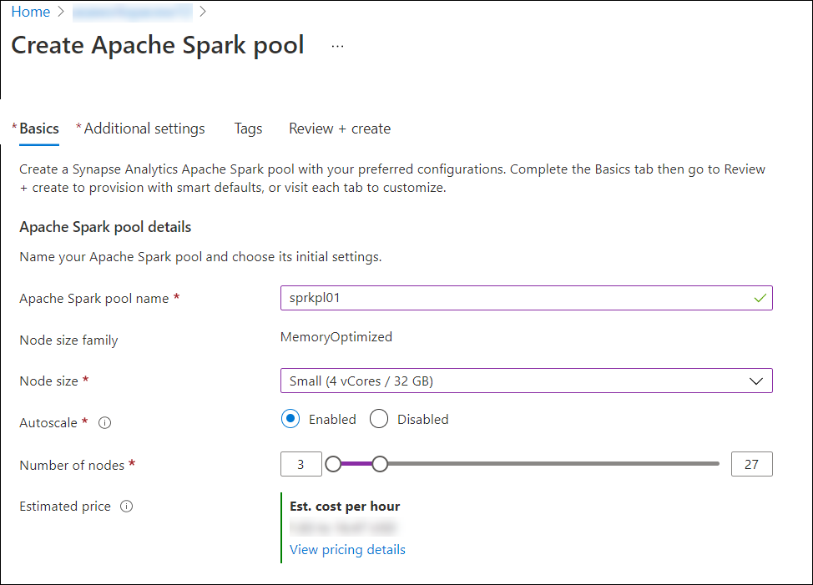
How to create an Apache Spark pool in Azure Synapse Analytics
Notes:
Talking Points:
Apache Spark Concepts in Azure Synapse Analytics;​
​
Spark pools:​
A Spark pool is created in the Azure portal. It is the definition of a Spark pool that, when instantiated, it creates a Spark instance that processes data. When a Spark pool is created, it exists only as metadata; no resources are consumed, running, or charged for. A Spark pool has a series of properties that control the characteristics of a Spark instance; these characteristics include but are not limited to name, size, scaling behavior, time to live.​
As there is no dollar or resource cost associated with creating Spark pools, any number can be created with any number of different configurations. Permissions can also be applied to Spark pools allowing users only to have access to some and not others.​
A best practice is to create smaller Spark pools that may be used for development and debugging and then larger ones for running production workloads.​
You can read how to create a Spark pool and see all their properties here Get started with Spark pools in Synapse Analytics​
​​
​Spark Instances:​
Spark instances are created when you connect to a Spark pool, create a session, and run a job. As multiple users may have access to a single Spark pool, a new Spark instance is created for each user that connects.​
When you submit a second job, then if there is capacity in the pool, the existing Spark instance also has capacity then the existing instance will process the job; if not and there is capacity at the pool level, then a new Spark instance will be created.​​
​
Instructor notes and guidance.
Note that this architecture is both valid for Apache Spark pools in Azure Synapse Analytics as well as for Azure Databricks. It outlines the general understanding of what Apache Spark is and how it interacts with different services. ​
​
Recommended reading for this slide
https://docs.microsoft.com/en-us/learn/modules/understand-big-data-engineering-with-apache-spark-azure-synapse-analytics/4-when-do-you-use-apache-spark-pools

Slide 8
Lesson 02: Ingest data with Apache Spark notebooks in Azure Synapse Analytics
Notes:
Instructor notes
This space has been left deliberately blank

Slide 9
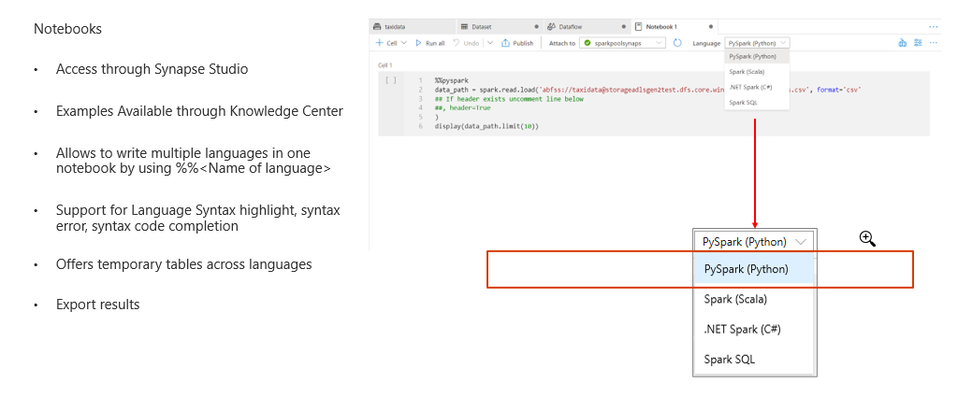
Apache Spark notebooks features in Azure Synapse Analytics
Notes:
Talking Points​
​
Through the develop hub in the synapse workspace you can create notebooks. ​These notebooks can be written in multiple languages like PySpark, Spark SQL etc. ​The notebook environment supports for language syntax highlights, syntax errors and code completion.
​
​Instructor notes and guidance.
The benefits of using the Azure Synapse Studio environment where you have the notebook availability gives you flexibility in scaling per notebook session. So scaling up and down between notebooks is possible, and writing in multiple language and passing through of keys where the datasets is stored gives you the flexibility in performing data engineering without switching tools. ​
​
​Recommended reading for this slide
​https://docs.microsoft.com/en-us/learn/modules/ingest-data-with-apache-spark-notebooks-azure-synapse-analytics/2-introduction-spark-notebooks
https://docs.microsoft.com/en-us/learn/modules/ingest-data-with-apache-spark-notebooks-azure-synapse-analytics/3-understand-use-cases

Slide 10
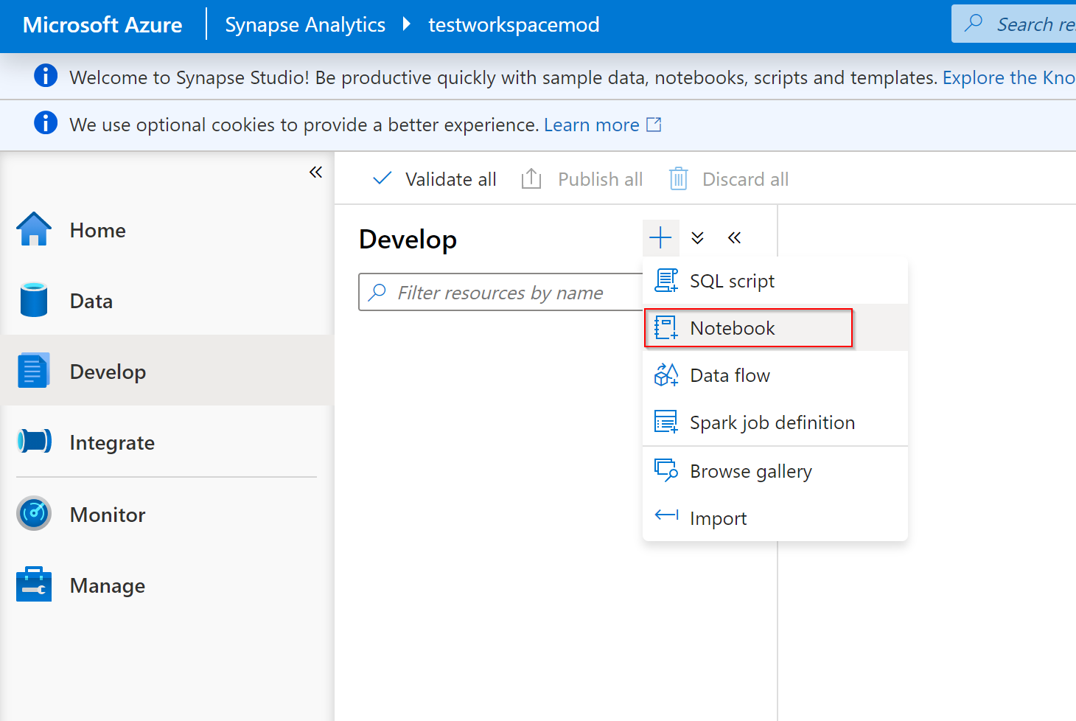
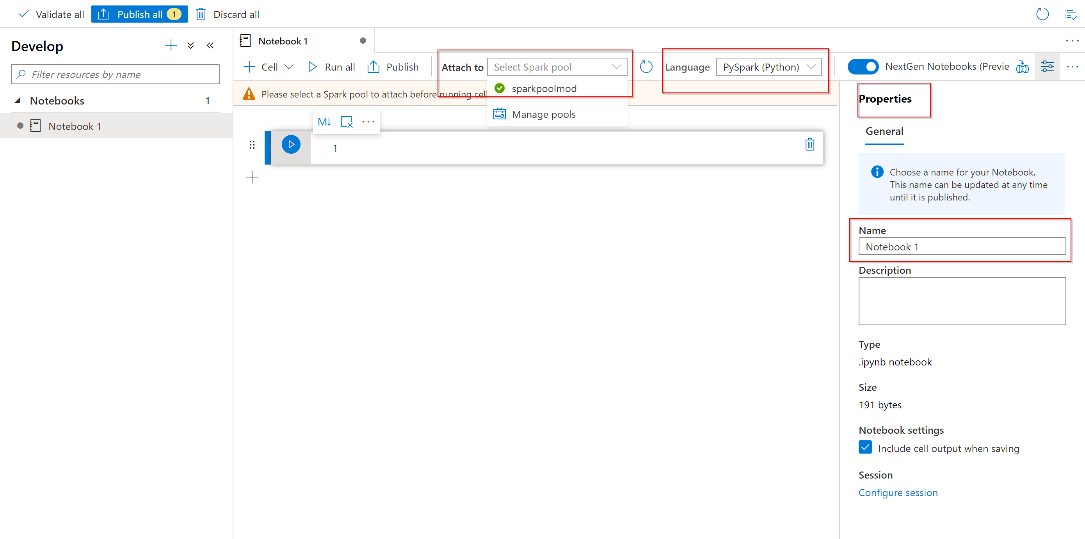
Creating a notebook in Azure Synapse Analytics
Notes:
Talking Points​
​
You can access data in the primary storage account directly. There's no need to provide the secret keys. In Data Explorer in the Synapse Workspace, right-click on a file and select New notebook to see a new notebook with data extractor autogenerated.​
You can configure the Spark pool by changing the spark session per notebook. Here you can specify when the session should time out, how many spark executors you would like to use as well as the size of the executers and the driver size. You have the flexibility per Spark session to configure the compute resource that you would need on demand. ​
​
​Instructor notes and guidance.
You can also create blank notebooks and configure the session of the notebook too.
​
​Recommended reading for this slide
https://docs.microsoft.com/en-us/learn/modules/ingest-data-with-apache-spark-notebooks-azure-synapse-analytics/4-exercise-create-spark-notebook
​

Slide 11
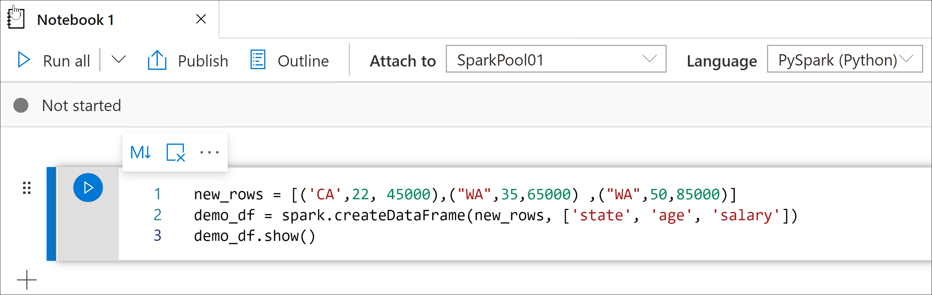
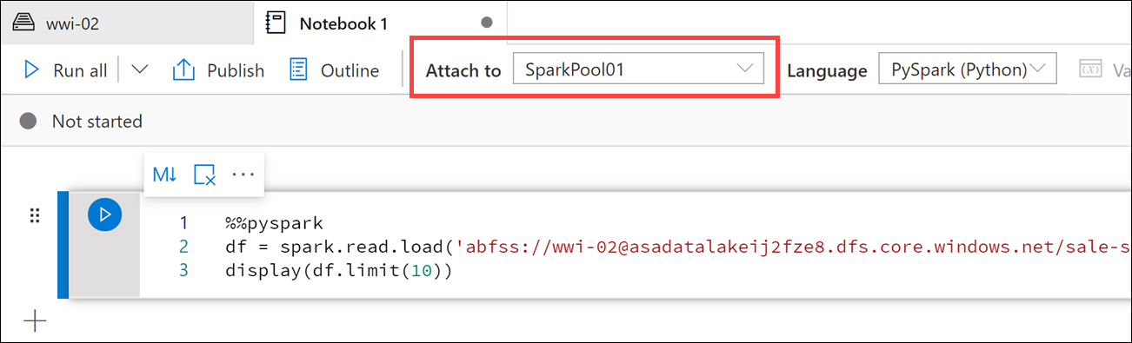
Ingest data with Apache Spark notebooks in Azure Synapse Analytics
Generating data while executing the command
Loading data in a single command from a data file
Notes:
Talking Points​
​
It is also possible to create your own DataFrame within Azure Synapse Analytics running on a Spark Pool within the Data hub of the Azure Synapse workspace. This is done by manually defining the DataFrame structure as you write the DataFrame in the language of your choice​.
​
You can load data from Azure Blob Storage, Azure Data Lake Store Gen 2, and SQL pool. ​For example, you can ingest data into a Spark DataFrame by reading a CSV from an Azure Data Lake Storage Gen 2 as a Spark DataFrame. ​
​
​Instructor notes and guidance.
Consider creating examples that you can show to the students via a demo
​
​Recommended reading for this slide
https://docs.microsoft.com/en-us/learn/modules/ingest-data-with-apache-spark-notebooks-azure-synapse-analytics/10-load-data
https://docs.microsoft.com/en-us/learn/modules/ingest-data-with-apache-spark-notebooks-azure-synapse-analytics/11-exercise-load-data
​

Slide 12
Lesson 03: Transform data with DataFrames in Apache Spark Pools in Azure Synapse Analytics
Notes:
Instructor notes
This space has been left deliberately blank

Slide 13
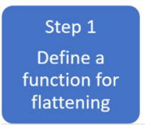
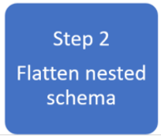
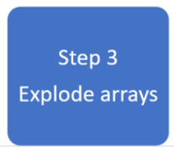
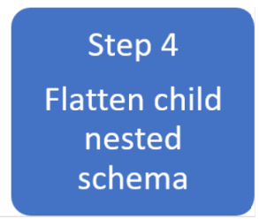

Transform data with DataFrames in Apache Spark Pools in Azure Synapse Analytics
Notes:
TALKING POINTS
A common use case for using Apache Spark pools in Azure Synapse Analytics is for transforming complex data structures using DataFrames. It can help for the following reasons:
Complex data types are increasingly common and represent a challenge for data engineers as analyzing nested schema and data arrays tend to include time-consuming and complex SQL queries.
It can be difficult to rename or cast the nested column data type.
Performance issues arise when working with deeply nested objects. Data Engineers need to understand how to efficiently process complex data types and make them easily accessible to everyone. In the following example, Synapse Spark is used to read and transform objects into a flat structure through data frames.
Synapse SQL serverless is used to query such objects directly and return those results as a regular table.
With Synapse Spark, it's easy to transform nested structures into columns and array elements into multiple rows.
In the example the following steps show the techniques involved to deal with complex data types by creating multiple DataFrames to achieve the desired result.
Step 1: Define a function for flattening
We create a function that will flatten the nested schema.
Step 2: Flatten nested schema
We will define the function you create to flatten the nested schema from one DataFrame into a new DataFrame.
Step 3: Explode Arrays
Here you will transform the data array from the DataFrame created in step 2 into a new DataFrame.
Step 4: Flatten child nested Schema
Finally, you use the transformed DataFrame created in step 3 and load the cleansed data into a destination DataFrame to complete the work
​Instructor notes and guidance.
For students it’s important to understand how to transform complex data with DataFrames in Apache Spark Pools. This slide gives you an overview of the step-by-step approach you would take to flatten a nested structure. The lab will enable the students to use the detailed steps of this process.
​
​
Recommended reading for this slide
https://docs.microsoft.com/en-us/learn/modules/transform-data-with-dataframes-apache-spark-pools-azure-synapse-analytics/

Slide 14
Lesson 04: Integrate SQL and Apache Spark pools in Azure Synapse Analytics
Notes:
Instructor notes
This space has been left deliberately blank

Slide 15
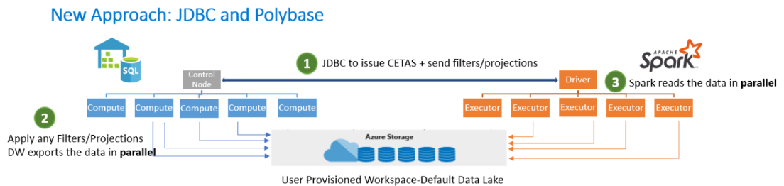
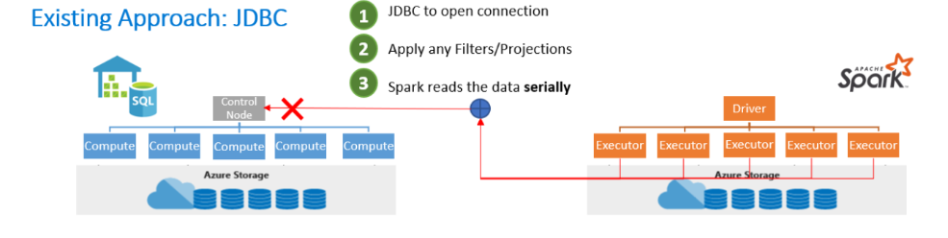
Integrate SQL and Apache Spark pools in Azure Synapse Analytics
Notes:
Talking Points:
General info:
The Azure Synapse Apache Spark to Synapse SQL connector is designed to efficiently transfer data between Spark pools and dedicated SQL pools in Azure Synapse Analytics. The Azure Synapse Apache Spark to Synapse SQL connector works on a dedicated SQL pools only, it doesn't work with serverless SQL pool.
Design
The existing approach is transferring data between Spark pools and SQL pools can be done using JDBC. However, given two distributed systems such as Spark and SQL pools, JDBC tends to be a bottleneck with serial data transfer.
A new approach can include the Azure Synapse Apache Spark pool to Synapse SQL connector as a data source implementation for Apache Spark. It uses the Azure Data Lake Storage Gen2 and Polybase capabilities in dedicated SQL pools to efficiently transfer data between the Spark cluster and the Synapse SQL instance. It is also possible to write a Spark DataFrame into a dedicated SQL Pool using a PySpark Connector.
Assume you have a DataFrame named "pyspark_df" that you want to write into the data warehouse. Here are the steps required:
Step 1: Create a temp table using the DataFrame in PySpark:
Step 2: Run a Scala cell in the PySpark notebook using magic (%%) commands:
Similarly, in the read scenario, read the data using Scala and write it into a temp table, and use Spark SQL in PySpark to query the temp table into a DataFrame.
Instructor notes and guidance.
This is a build slide
Click 1: Shows the existing approach using JDBC
Click 2: Removes the existing approach
Click 3: Shows the new approach using PolyBase
This slide is used to showcase the easy of use and flexibility of the notebook environment to switch between Spark pools and SQL pools for read/write operations and to give the student an understanding of the approaches to integrating SQL and Apache spark pools in Azure Synapse Analytics. More info can be found here: https://docs.microsoft.com/en-us/azure/synapse-analytics/spark/synapse-spark-sql-pool-import-export
You are entitled to use an example like * load CSV files from an ADLS Gen2 storage account in a Spark notebook and write the data to a staging table in the dedicated QL Pool, and then read back from the SQL table into a DataFrame. You can also load other flat files and join with SQL data for lookup operations too.
Recommended reading for this slide
https://docs.microsoft.com/en-us/learn/modules/ingest-data-with-apache-spark-notebooks-azure-synapse-analytics/

Slide 16
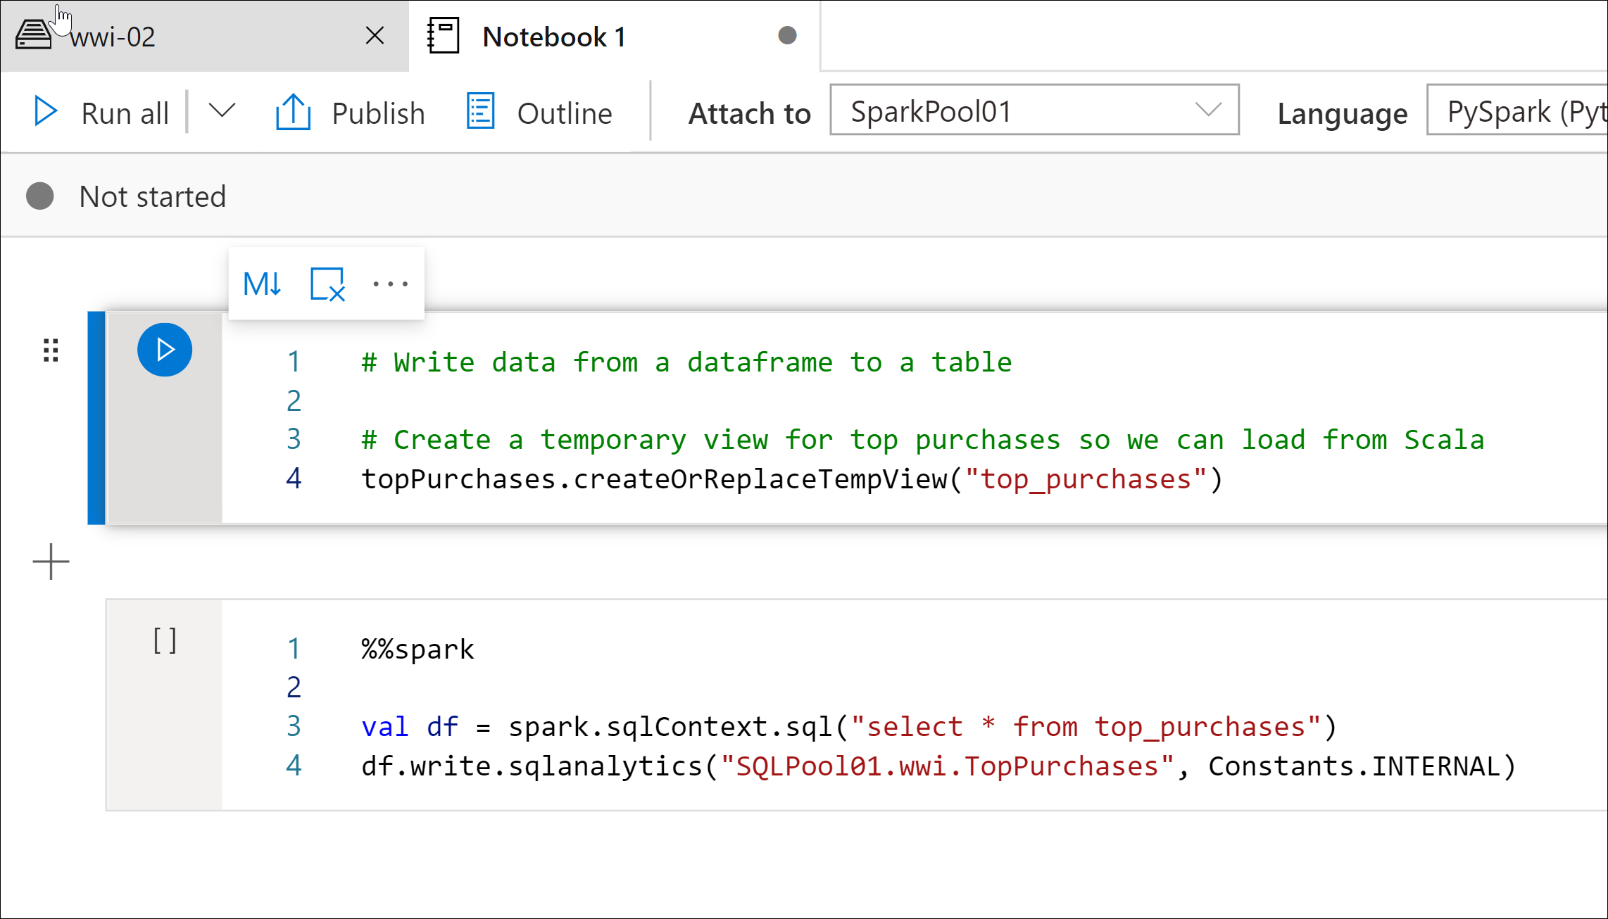
Write data from Apache Spark pools to a dedicated SQL pool
Notes:
Talking Points:
The Azure Synapse Apache Spark pool to Synapse SQL connector is a data source implementation for Apache Spark. It uses the Azure Data Lake Storage Gen2 and PolyBase in SQL pools to efficiently transfer data between the Spark cluster and the Synapse SQL instance.
If we want to use the Apache Spark pool to Synapse SQL connector (sqlanalytics), one option is to create a temporary view of the data within the DataFrame. Execute the code below in a new cell to create a view named top_purchases:
# Create a temporary view for top purchases
topPurchases.createOrReplaceTempView("top_purchases")
We must execute code that uses the Apache Spark pool to Synapse SQL connector in Scala. To do so, we add the %%spark magic to the cell. Execute the code below in a new cell to read from the top_purchases view:
%%spark
// Make sure the name of the SQL pool (SQLPool01 below) matches the name of your SQL pool.
val df = spark.sqlContext.sql("select * from top_purchases")
df.write.sqlanalytics("SQLPool01.wwi.TopPurchases", Constants.INTERNAL)
Instructor notes and guidance.
Many ETL operations on traditional on-premises data warehousing solutions contain routines that can take a tremendous amount of time due to the limitations of the hardware and the SMP systems on which they run. These routines can be reduced from hours to minutes by performing them on an Apache Spark cluster and then transferring the results to a data warehouse table, so this will be a relevant topic to many of your students.
Recommended reading for this slide
https://docs.microsoft.com/en-us/learn/modules/integrate-sql-apache-spark-pools-azure-synapse-analytics/7-exercise-integrate-sql

Slide 17
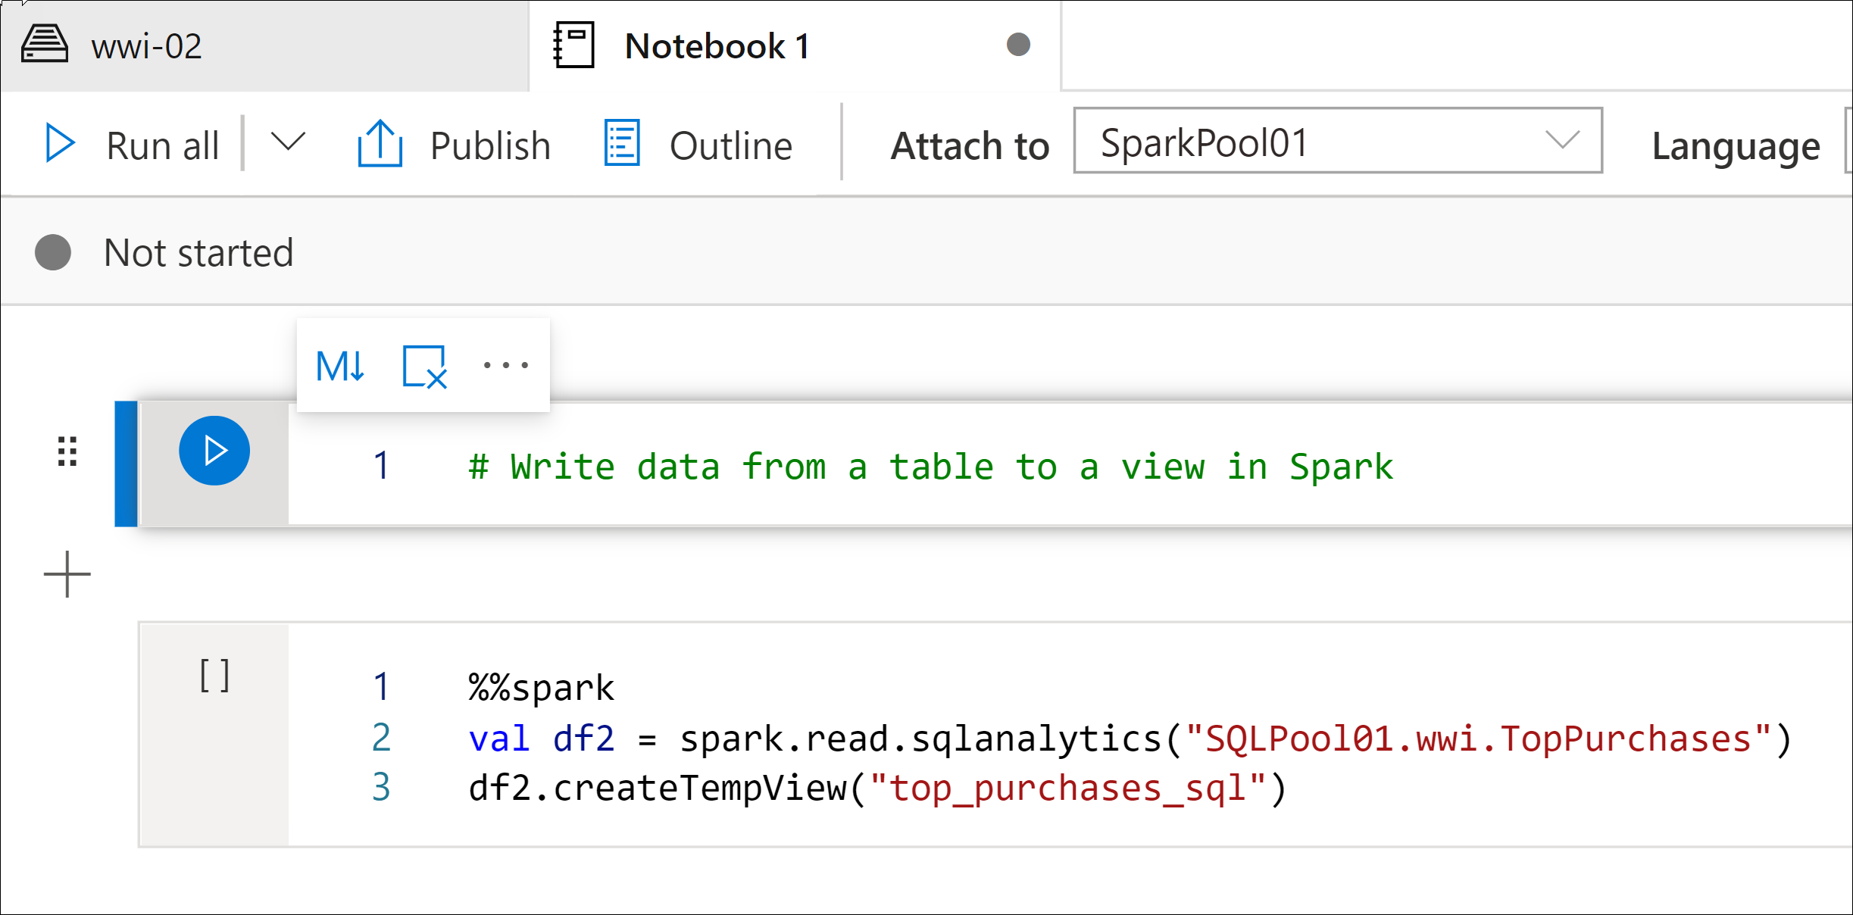
Write data from a dedicated SQL pool to Apache Spark pools
Notes:
Talking Points:
You can transfer data to and from a dedicated SQL pool using a Pyspark Connector, which currently works with Scala. The first thing to do is to create a temporary table in a DataFrame in PySpark using the createOrReplaceTempView method
pyspark_df.createOrReplaceTempView("pysparkdftemptable")
Next, you would have to run a Scala cell in the PySpark notebook using magics (since we're using different languages, and it will only work in Scala):
%%spark
val scala_df = spark.sqlContext.sql ("select * from pysparkdftemptable")
scala_df.write.sqlanalytics("sqlpool.dbo.PySparkTable", Constants.INTERNAL)
By using "val scala_df", we create a fixed value for the scala_dataframe, and then use the statement "select * from pysparkdftemptable", that returns all the data that we created in the temporary table in the previous step, and storing it in a table named sqlpool.dbo.PySparkTable
Instructor notes and guidance.
Just as you will transfer data from Spark to a dedicated SQL pool table, the reverse is true while transferring data between the two distributed systems
Recommended reading for this slide
https://docs.microsoft.com/en-us/learn/modules/integrate-sql-apache-spark-pools-azure-synapse-analytics/10-transfer-data-outside-synapse-workspace-using-pyspark-connector

Slide 18
Review questions
Q01 – What is an element of a Spark Pool in Azure Synapse Analytics?
A01 – Spark Instance
Q02 – How can all Apache Spark notebooks in Synapse Studio be saved?
A02 – Select the Publish all button on the workspace command bar.
Q03 – When is it unnecessary to use import statements for transferring data between a dedicated SQL and Spark pool?
A03 – Use the integrated notebook experience from Azure Synapse Studio.
Notes:
Instructor notes and guidance.
This space has been left deliberately blank

Slide 19
Lab: Explore, transform, and load data into the Data Warehouse using Apache Spark
Notes:
Instructor notes and guidance.
This space has been left deliberately blank

Slide 20
Lab overview
This lab teaches you how to explore data stored in a data lake, transform the data, and load data into a relational data store. You will explore Parquet and JSON files and use techniques to query and transform JSON files with hierarchical structures. Then you will use Apache Spark to load data into the data warehouse and join Parquet data in the data lake with data in the dedicated SQL pool.
Lab objectives
After completing this lab, you will be able to:
Perform Data Exploration in Synapse Studio
Ingest data with Spark notebooks in Azure Synapse Analytics
Transform data with DataFrames in Spark pools in Azure Synapse Analytics
Integrate SQL and Spark pools in Azure Synapse Analytics
Notes:
Instructor notes and guidance.
In the lab, we take the opportunity to explore data stored in a data lake, transform the data, and load data into a relational data store. The student will explore Parquet and JSON files and use techniques to query and transform JSON files with hierarchical structures. Then the student will use Apache Spark to load data into the data warehouse and join Parquet data in the data lake with data in the dedicated SQL pool. In this lab you will:
Perform Data Exploration in Synapse Studio
Ingest data with Spark notebooks in Azure Synapse Analytics
Transform data with DataFrames in Spark pools in Azure Synapse Analytics
Integrate SQL and Spark pools in Azure Synapse Analytics

Slide 21











Lab 05 Overview
asacosmosdb<unique_suffix>
CosmosDB
Campaign Info
Azure Databricks
asagadatalake<unique_suffix>
Cluster
Azure Data Lake
wwi-02
Sales (parquet)
Customer (csv)
dp203sql<unique_suffix>
SourceDB
Azure Synapse Analytics
Dedicated SQL Pool (SQLPool1)
Built-In Serverless SQL Pool
Apache Spark pool
Pipelines and Dataflows
Power BI
asagaworkspace<unique_suffix>
Notes:
This slide is an optional slide that you can use to show a high-level overview of the technologies used in the lab.
This lab teaches you how to explore data stored in a data lake, transform the data, and load data into a relational data store. You will explore Parquet and JSON files and use techniques to query and transform JSON files with hierarchical structures. Then you will use Apache Spark to load data into the data warehouse and join Parquet data in the data lake with data in the dedicated SQL pool.

Slide 22
Lab review
Q01 – Which command is used to analyze parquet files and infer schema’s using the Spark Engine?
Q02 – What is an option to you query JSON files using the SQL syntax in an Apache Spark Notebook connected to a Spark Pool in Azure Synapse Analytics?
Q03 – How do you set the language of a cell in an Apache Spark Notebook?
Notes:
Answers
Question 1 – df.printSchema()
Question 2 - Create a temporary view of the data within the DataFrame using df.createOrReplaceTempView(“NameOfView”)
Question 3 - By using the magic %% command followed by the language, i.e. %%SQL

Slide 23
Module summary
In this module, you have learned about:
Azure Synapse Analytics
Apache Spark Notebooks
Integration of SQL and Spark
DataFrames
Apache Spark Architecture
Next steps
After the course, consider visiting [Azure Apache Spark for Azure Synapse Analytics]. The Apache Spark in Azure Synapse Analytics provides an overview of how Apache Spark is integrated with Azure Synapse Analytics.
Notes:
Instructor notes and guidance.
The next steps is suggested post course learning materials to reinforce what they have learned in the module.

Slide 24
Closing slide
Notes:
Instructor notes and guidance.
This space has been left deliberately blank

